Slide 1


ESTD 1957
HIGH POWER SEMICONDUCTOR DEVICES
MICROWAVE PRODUCTS
RESEARCH & DEVELOPMENT

Slide 2

Strong business partner
On the basis of the regulation of the Minister of Mechanical Industry of 8 March 1957, Zakłady Lamp Nadawczych LAMINA in the process of construction with its registered office in Piaseczno was established. The company has been carrying on its business for over 60 years and since 2013 it has been trading in under the name of Kubara Lamina S.A.
Kubara Lamina’s business focuses on innovativeness and creates ground-breaking technological solutions. The company’s business philosophy is reflected in its product offer, which comprises solutions targeted at the most demanding markets.
Based on our long-lasting experience and expertise, we develop the power, electrical and arms industry that is capable of delivering technologically advanced and innovative projects.
We constantly develop our resources and skills by reacting fast to changes taking place in the world in order to meet our business partners’ requirements in Poland and abroad.
Based on market knowledge and international experience, Kubara Lamina offers the highest quality products and services, thus creating added value for customers.

Slide 3
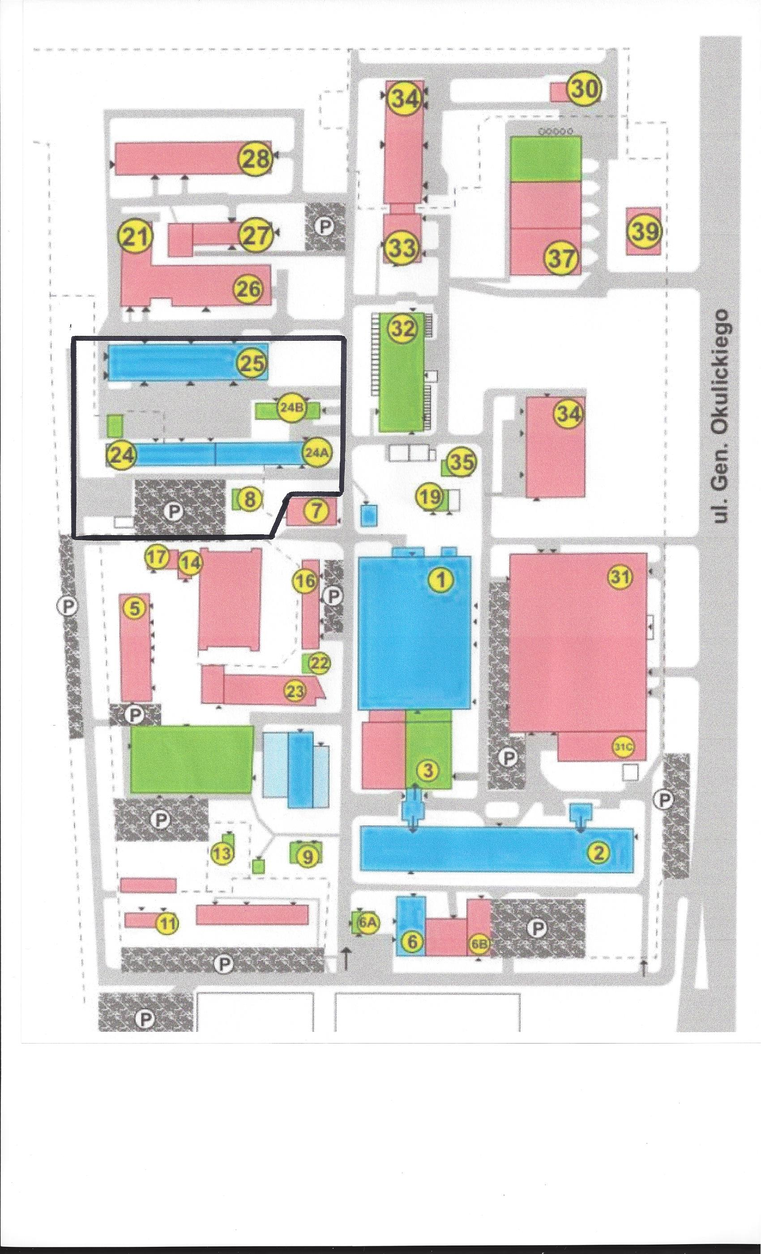
HUMAN RESOURCES AND INFRASTRUCTURE
Employment ~ 180 employees
Warehouse and industrial infrastructure:
Kubara Lamina area of 8 ha
37 000 m2 of buildings: offices, warehouses, production halls, of which 12 000 are rentedh (94 companies)
Technical infrastructure:
energy
water, deionized water
sewage neutralizer
technical gases (nitrogen, oxygen, hydrogen, concentrated air )
natural gas
heating
Additional facilities:
direct connection with national road No. 79
direct connection with the S2 express road, which connects the A2 motorway
international airport Chopin (15 km)
construction of a direct entry / exit connection to Gen. Okulickiego street and construction of a direct entry / exit connection to Puławska street

Slide 4
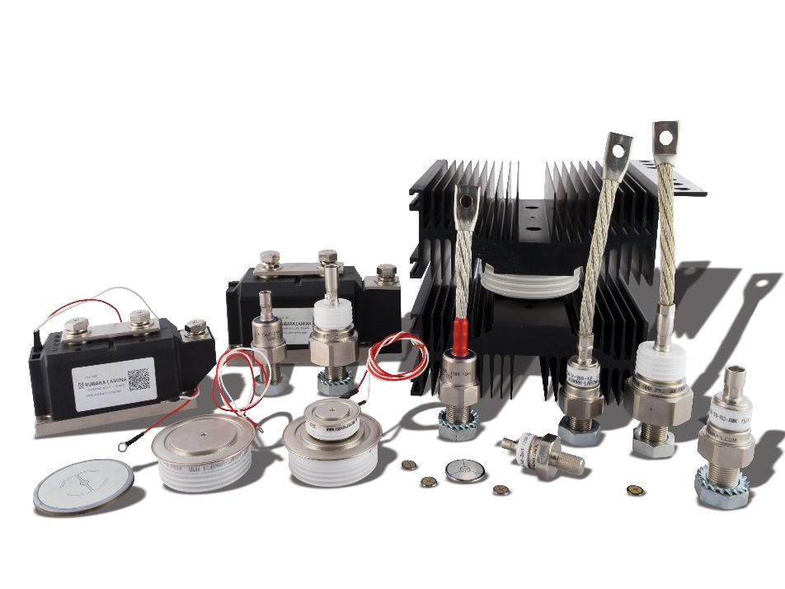
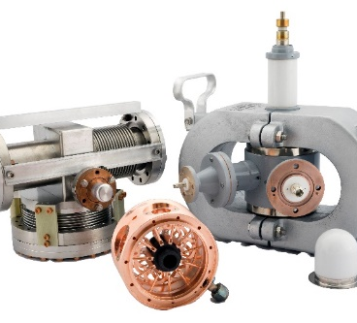
ACTIVITY
high power semiconductor devices
assembly of power electronic devices
microwave products
Research & Development Center
renatl of space

Slide 5
HIGH POWER SEMICONDUCTOR DEVICES
Kubara Lamina is a producer of high power semiconductors based on Westinghouse Corp. USA.
The semiconductor devices manufactured in the Company are used in power electronics and military industry.
Our offer:
diodes medium and high power, standard and fast
thyristors standard, fast ans inverter
power modules
The recipients of Kubara Lamina products are leaders in their industries, including.: ABB, Polskie Koleje Państwowe, Tramwaje Warszawskie, Bombardier, Powerex USA
Main aplication:
railway traction
UPS
diesel electric locomotives made by Electro Motiv Diesel USA and GE Transportation
defence industry(Boeing AH-64 Apache attack helicopter, Lockheed Martin F-35 Lightning II , Boeing F/A-18E/F Super Hornet)

Slide 6
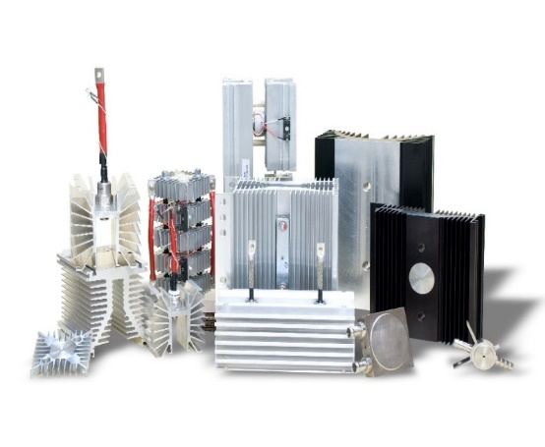
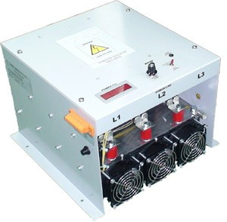
Service of machines and devices
ASSEMBLY OF POWER ELECTRONIC DEVICES
Kubara Lamina offers design, construction and modernization services for power electronics components and devices.
We offer our clients catalog solutions and unusual applications, according to the design and investor's guidelines. Ready devices are tested to ensure a high level of quality.
We have extensive experience in the installation of control, distribution and executive devices in a wide range of power and voltage.
We provide comprehensive service in the field of design, installation and configuration of equipment.
We offer professional support at every stage of the investment.
Our offer:
power blocks
rectifiers
service of machines and devices

Slide 7
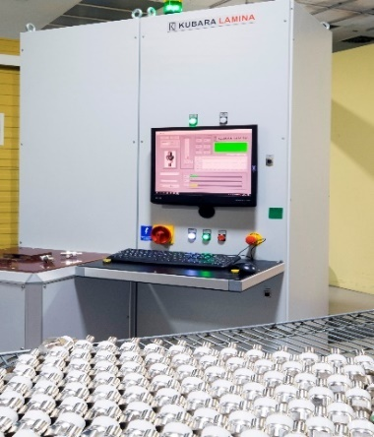
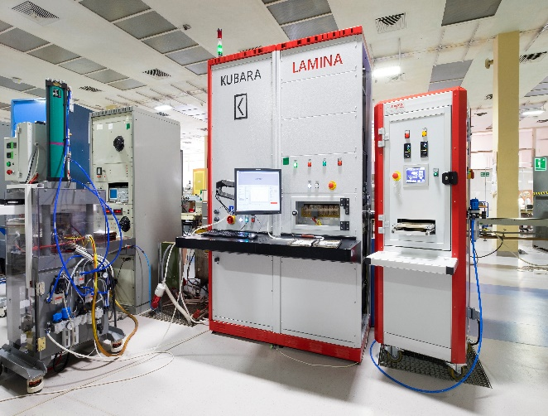
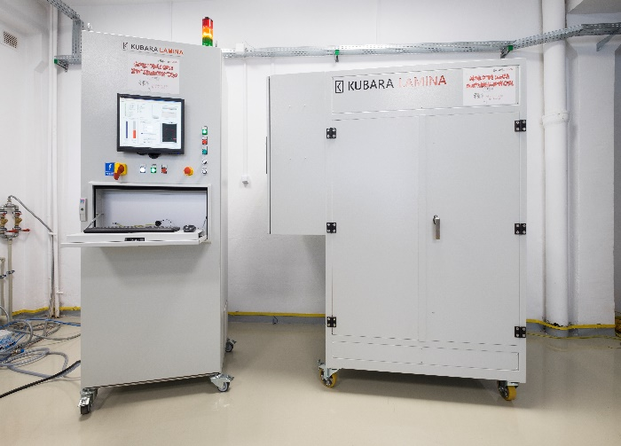
TESTERS AND INDUSTRY AUTOMATION
Testers are devices that allow automatic checking of quality parameters of manufactured products, their monitoring and analysis in order to improve production and quality processes.We provide comprehensive service in the field of design, installation and configuration of equipment.
We provide warranty and post-warranty service for devices.
We offer professional support at every stage of the investment.
Our projects:
Qrr Test equipment of a reverse recovery charge in the power thyristors and power diodes. The tester is equipped with a PC and monitor. Can work with another computer, an external database and barcode reader. Connection to the press, the ability to communicate with the press via RS-232. Light Tower operating status tester.
Power diodes overload tester TB2. The tester is equipped with a PC and monitor Can work with another computer, an external database and barcode reader. Light Tower operating status tester.
High voltage switching power supply

Slide 8
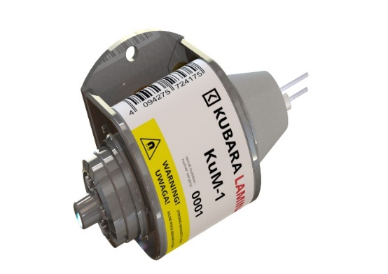
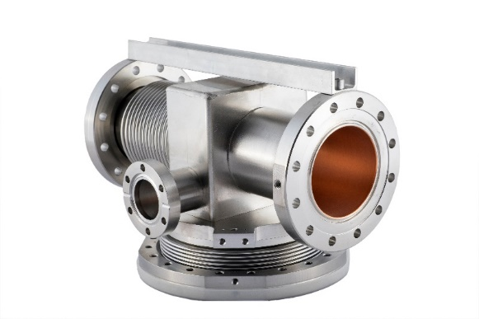
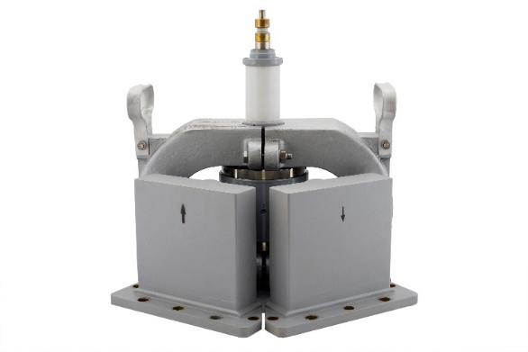
MICROWAVE PRODUCTS
The design and production of microwave products is one of the main areas of activity of Kubara Lamina. We offer our clients technologically advanced microwave devices, whose recipients are producers of the arms and power electronics industries as well as scientific and research units.
A world-class team of specialized engineers helps at every stage of the ongoing project
Our offer:
amplitrons
absorbers
magnetrons
duplexers

Slide 9
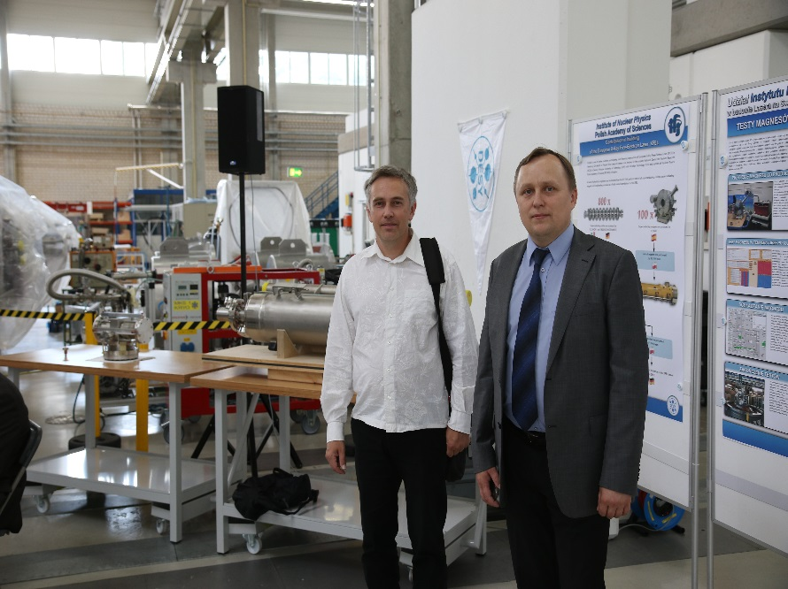
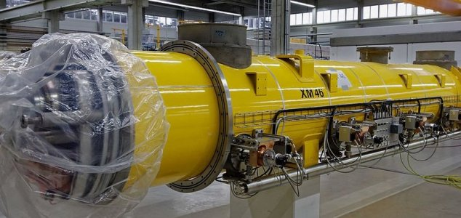
MICROWAVE PRODUCTS- ABSORBERS
HOM absorbers to suppress higher parasitic vibration modules. They were installed at the DESY Deutsches Elektronen-Synchrotron Notkestrasse 85 22607 Research Center in Hamburg (Germany), one of the largest scientific and research investments in Europe - the most modern X-ray free electron laser in the world as part of the XFEL research project. The infrastructure of the laser extends from the DESY Center up to Schenefeld, 3.5 km away. This international project connects scientists and engineers from many European and world countries, including the National Center for Nuclear Research and Kubar Lamina.
In 2017, Kubara Lamina won a contract funded by the US Department of Energy for the supply of components for the Linac Coherent Light Source (LCLS-II) free electron laser being constructed at the Stanford University SLAC laboratory.

Slide 10
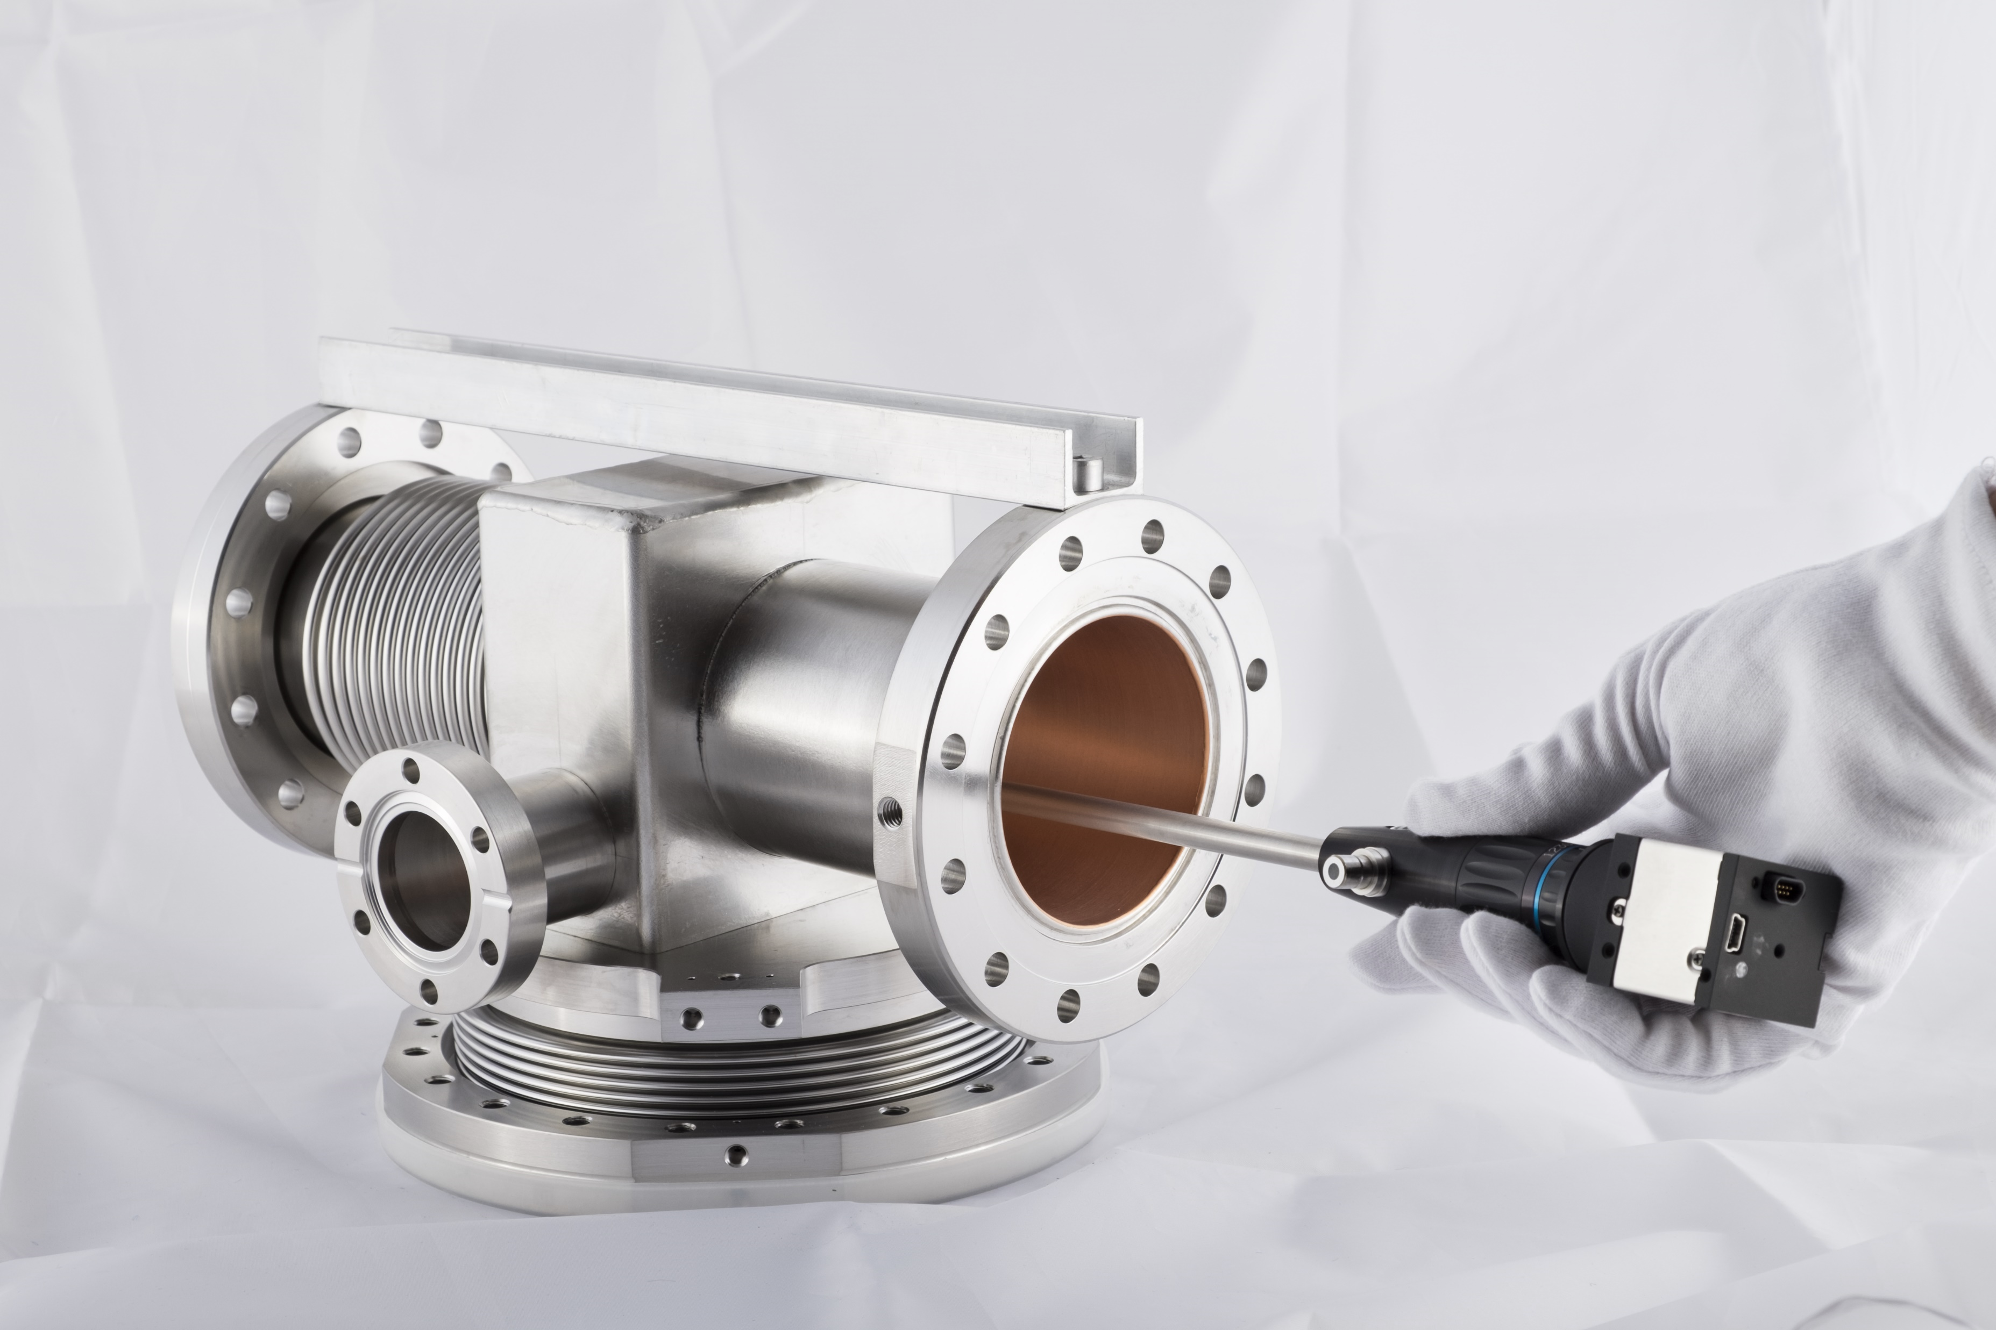
NEW TECHNOLOGY– REASEARCH AND DEVELOPMENT CENTER
R&D Centre Kubara Lamina was established in 2016 as a unit that performs tasks in the field of scientific, scientific and technical and innovative policy of the enterprise. The R&D Centre carries out projects connected with the modernisation of the company’s existing products, as well as innovative projects based on the most advanced technologies and tools.
In its R&D Centre, Kubara Lamina employs many experienced engineers who have great specialised knowledge. They have excellent conditions for professional development and a wide access to newly appearing technologies.
Many projects, studies and implementations are carried out in cooperation with the best universities and R&D centres.
The projects are of interdisciplinary and international character, they are created in cooperation with other centers, scientific institutions and universities.
The Company's partners include: WAT Warszawa, Instytut Elektrotechniki w Międzylesiu, Instytut Energetyki w Poznaniu, Instytut Elektrotechniki w Łodzi, Narodowe Centrum Badań Jądrowych w Świerku, Narodowe Centrum Badań i Rozwoju w Warszawie, Akademia Nauk w Krakowie, Instytut Technologii Elektronowej w Warszawie, PIT-RADWAR w Warszawie, Jefferson Lab USA.

Slide 11
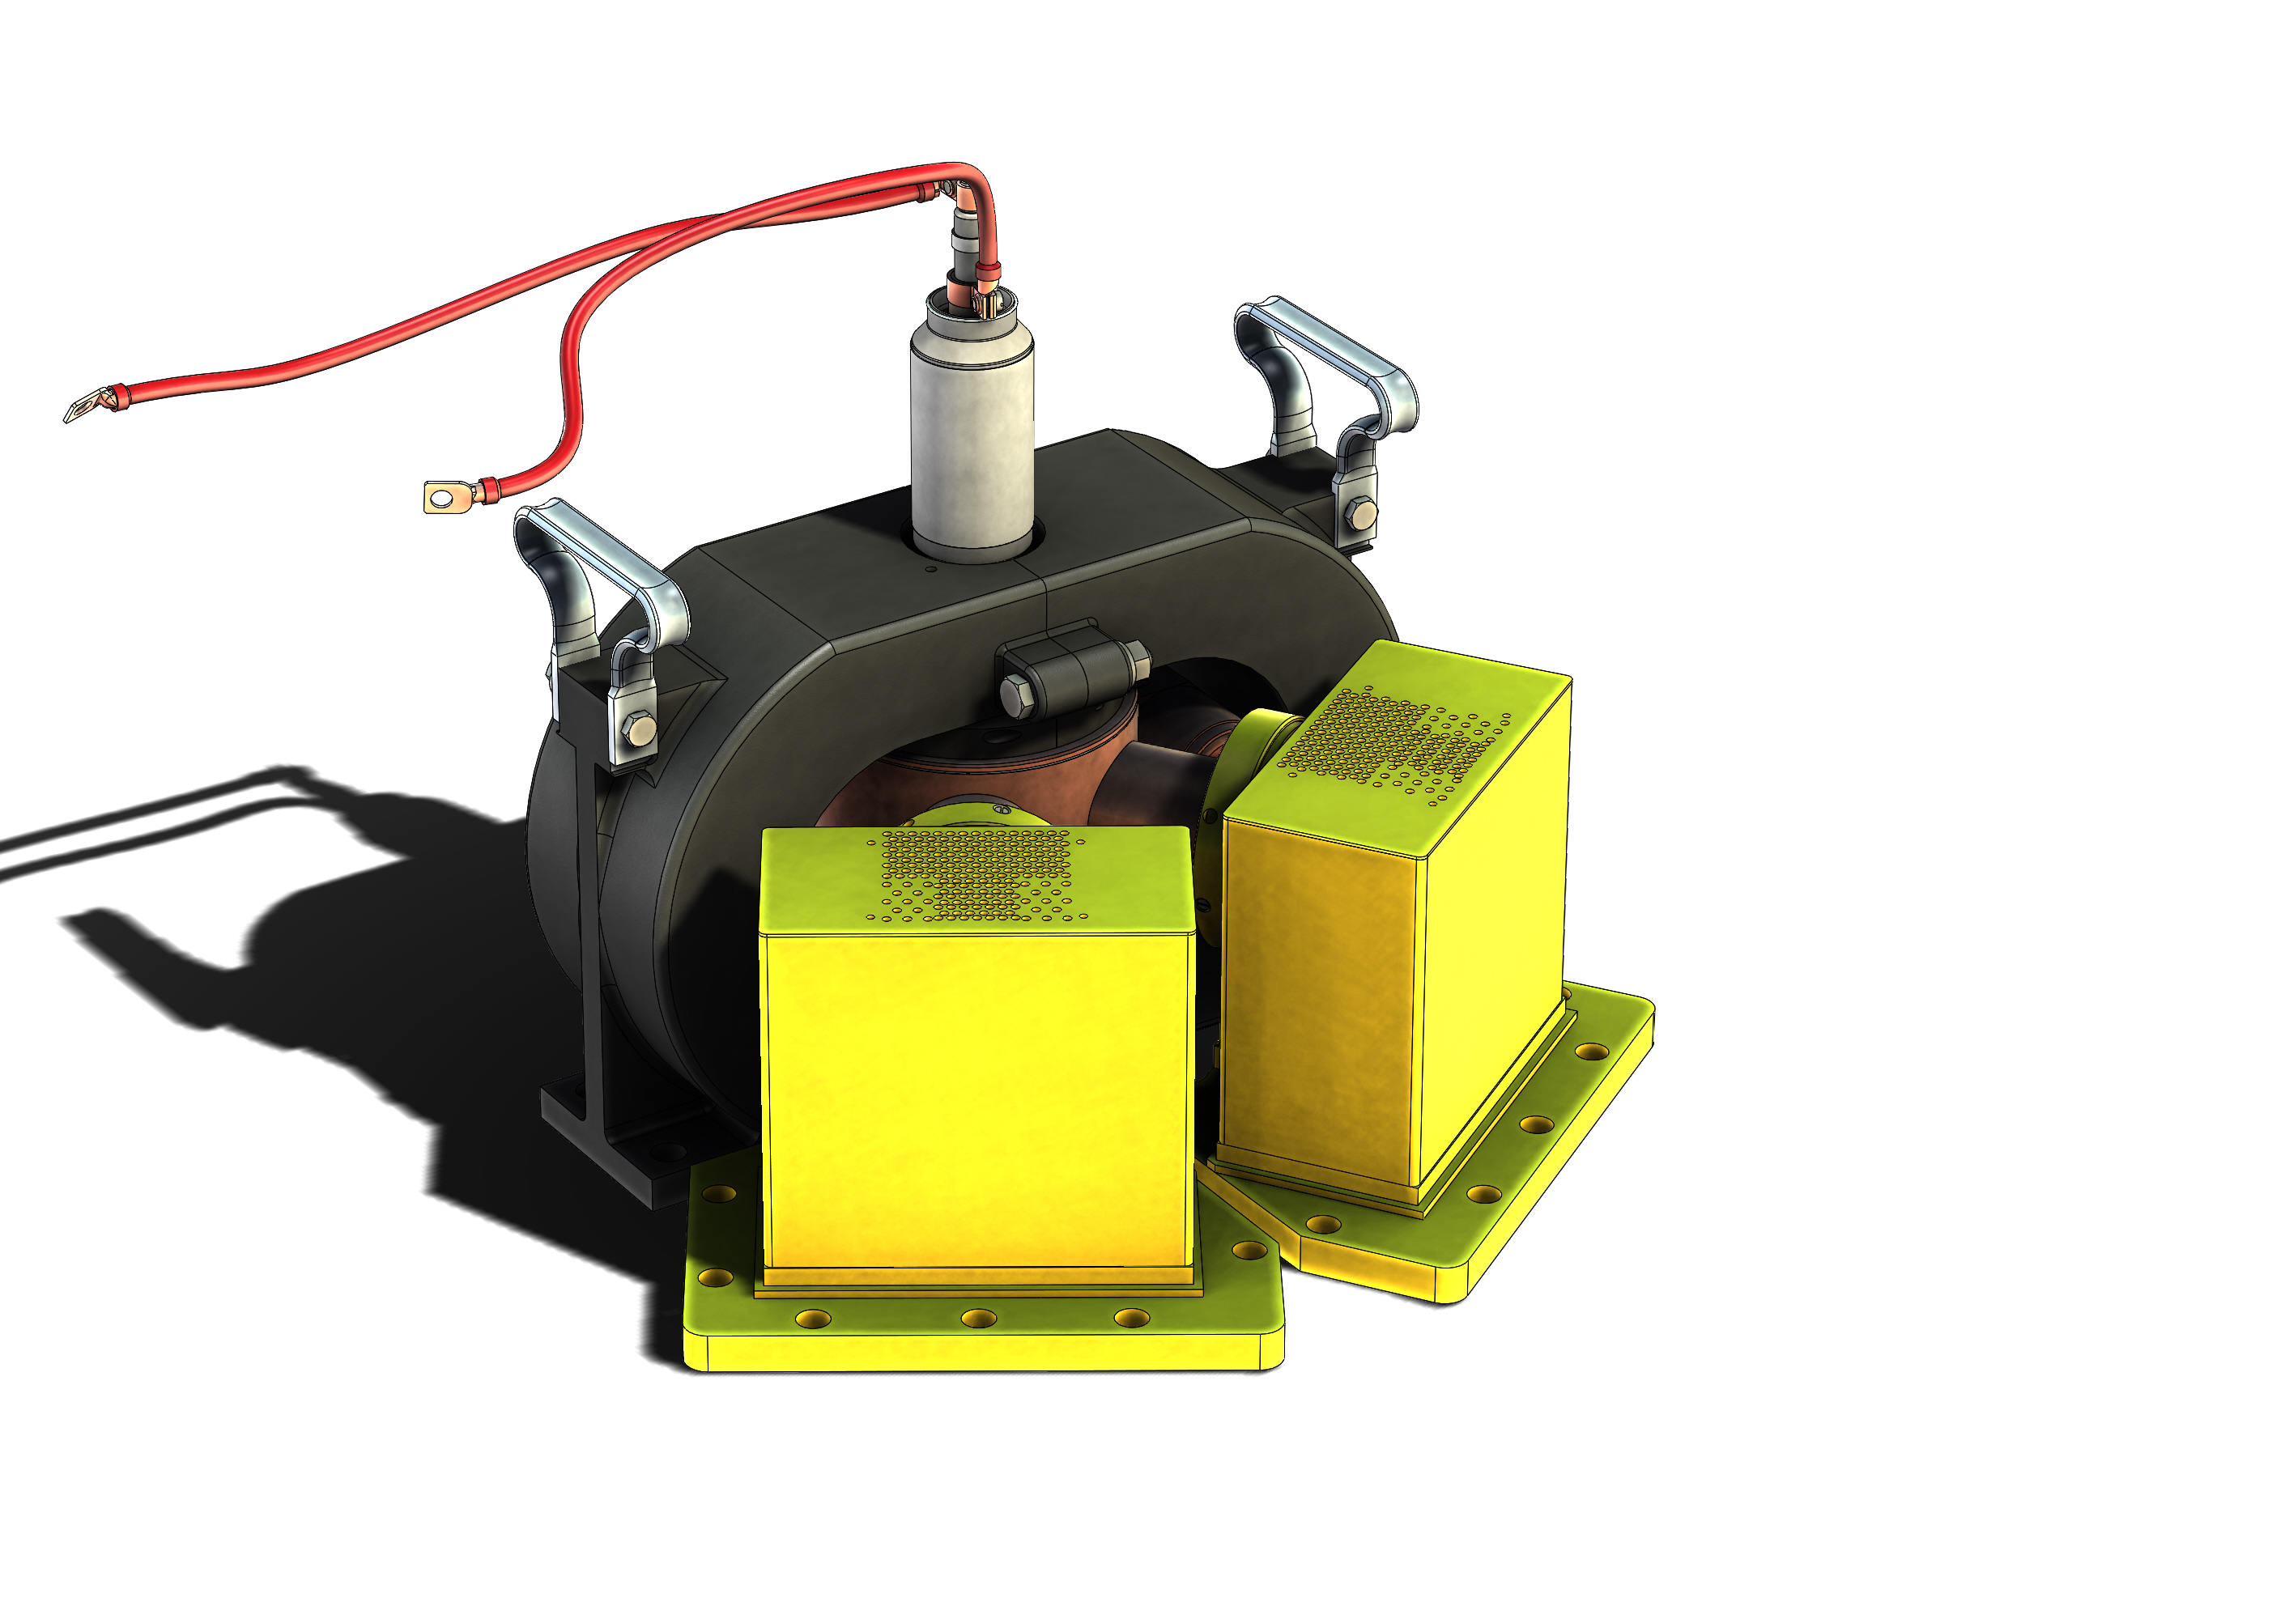
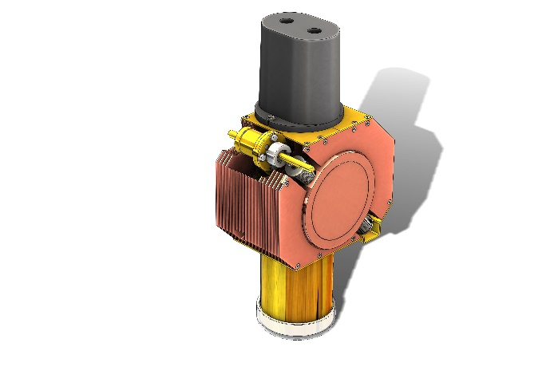

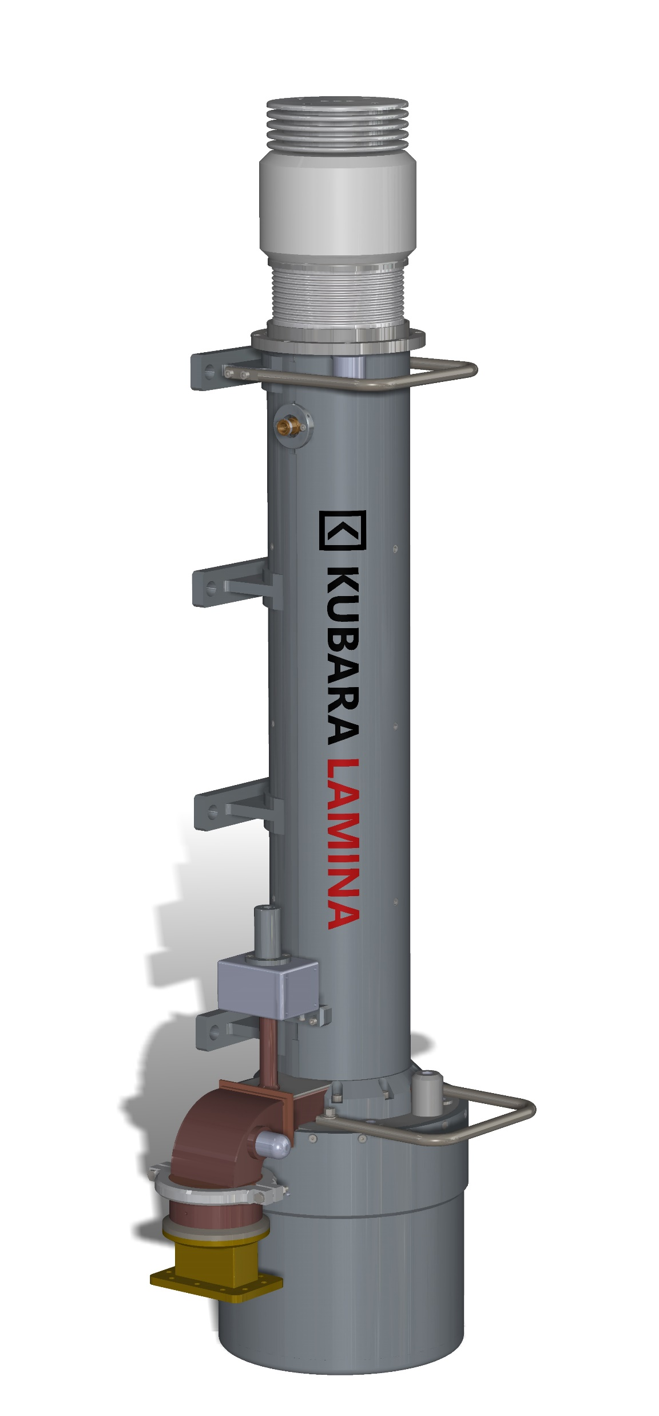
NEW TECHNOLOGY– REASEARCH AND DEVELOPMENT CENTER
Current projects:
LA-116 TUBE MODERNIZATION – Military radiolocation systems. The company conducts development work on improving the parametersof LA-116 tubes, used in transmitter of the NUR-12M station. The aim of the works is to extend the tube’s working time, lower the level of parasitic signals, as well as reduce the unwanted emission power level in the radioastronomy band and satellite earth tests (1400-1427MHz band).
CONTINOUS WAVE MAGNETRONS FOR 2.45 GHz (5.8 GHz) – Industry. Such microwave tubes are used in many industrial sectors: food industry: food processing and drying; chemical industry: accelerating chemical reactions; other industries: mainly to accelerate drying processes.
PULSED POWER MAGNETRON FOR Ku BAND - Radio lines between a control station and a flying object. In 2016, Kubara Lamina signed the Delivery Agreement No ZP/7/2016/R214/940/02/KO with the Military Institute of Armament Technology for the delivery of two magnetrons of 14 GHz (Ku band). The agreement covered the production and delivery of subassemblies to construct a radio line between the control station and flying object. The order was completed on 9.11.2016. Under the agreement, the company designed and produced 2 impulse-driven magnetrons of 300 W and 14 GHz.
HIGH POWER TRAVELLING WAVE TUBE - Military radiolocation systems. High power travelling wave tubes (TWT) operating in the S-band are applicable in military radiolocation systems. The design of the S-band tube, equivalent to the tube used in TRS-15 radars, is implemented by the Kubara Lamina in cooperation with specialists from the PIT-RADWAR S.A.

Slide 12
NEW TECHNOLOGY– REASEARCH AND DEVELOPMENT CENTER
KLYSTRON FOR C-BAND - Data transmission . The tube used to transmit data via radio communication. As part of its R&D, the company designs a model of a multi-resonant continuous wave klystron of around 2 kW to operate in the C band.
VACCUM CIRCUIT BREAKER - Safety elements and switchers in power systems
MICROWAVE GENERATOR FOR S-BAND - Medicine and radiotherapy. Dedicated to medical devices enabling radical radiotherapy and specialised procedures by the use of beam of photons, electrons and protons of high energies. Kubara Lamina undertook to design and produce an HPM source for the purpose of a project carried out by the Military Academy of Technology. As part of the project, it is to construct a high power microwave generator that will generate single or packages of impulses of the width of single µs. The generator will be based on the impulse-driven magnetron connected with an antenna and a battery of supercapacitors. The generator will incorporate an impulse-driven magnetron for S band of the output capacity of above 2MW, a power supply source based on supercapacitors of the voltage of around 50kV, as well as an antenna of the directionality of above 10 dBi. The HPM generator parameters will be controlled electronically. At present, the company designs an S-band magnetron block and a switched-mode power supply.

Slide 13
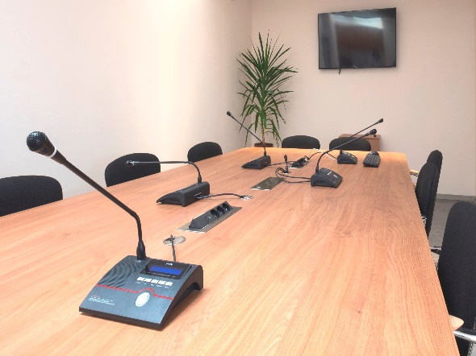
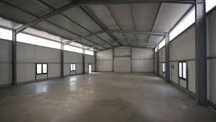
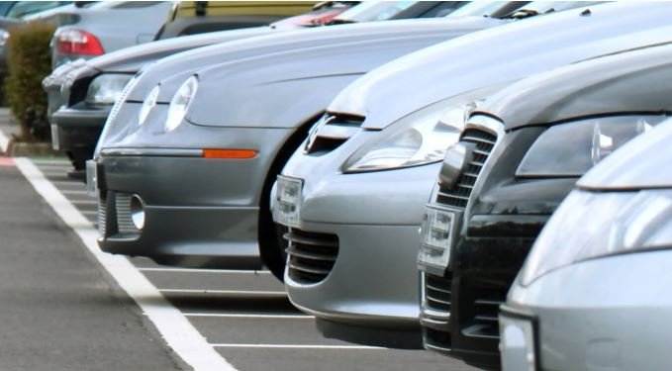
RENTAL OF SPACES
The area covers over 20,000 m2 of office, warehouse and production halls. We have a developed and professional technical and energy infrastructure necessary to conduct demanding businesses.
We provide the necessary energy utilities, we have our own water intake, chemical wastewater neutralizer, galvanizing plant and 4.5 MW boiler room with the possibility of power increase, we also have the installation of technical gases: hydrogen, nitrogen.
Offices
Areas from 15 m² to 35 m²
A large number of offices in a fenced area with security and social and sanitary facilities.
fenced area
Connection to the Internet and telephone networks. Parking place.
Production facilities and warehouses
Areas from 100 m² to 950 m²
The halls are located in buildings, on a fenced area with security. Social and sanitary facilities.
Utilities: electricity, own water intake, hydrogen, nitrogen, oxygen, heating, sewage neutralization, internet, telephones.
Parking
We offer parking spaces for both Tenants and others looking for a convenient parking space.

Slide 14

MANAGEMENT SYSTEMS & CERTIFICATES
KUBARA LAMINA – symbol of quality
To take care of user safety and top quality of our products, we manufacture all products in accordance with the company’s Integrated Management System. Being aware of our responsibility for quality, reliability, safety and solidity, we improve our production and organisational processes and search for better and better solutions and technologies all the time.
To improve our operations and meet increasing expectations of its Polish and international business partners, Kubara Lamina has implemented and maintains integrated management systems whose compliance with applicable standards is verified by independent certification units.
Management System ISO 9001:2015
Management System AQAP 2110:2016
WSK (Internal Control System) according to PN-EN ISO 9001:2015

Slide 15

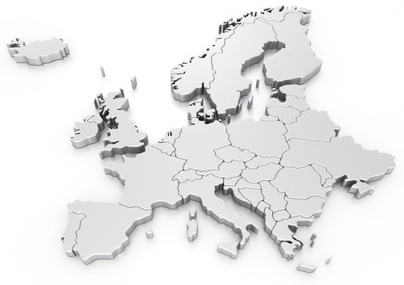

www.kubaralamina.com
ul. Puławska 34
05-500 Piaseczno POLAND

